Slide 1
JavaScript code transformation - AST
@darkyndy

Slide 2
TODO
Write your own JavaScript transpiling code

Slide 3
TODO
Write your own JavaScript transpiling code
Write linting rules that will enforce your team code conventions

Slide 4
TODO
Write your own JavaScript transpiling code
Write linting rules that will enforce your team code conventions
Write “code-mods” to automatically refactor your code

Slide 5

TODO
Write your own JavaScript transpiling code
Write linting rules that will enforce your team code conventions
Write “code-mods” to automatically refactor your code

Slide 6

TODO
Write your own JavaScript transpiling code
Write linting rules that will enforce your team code conventions
Write “code-mods” to automatically refactor your code

Slide 7
TODO
Write your own JavaScript transpiling code
Write linting rules that will enforce your team code conventions
Write “code-mods” to automatically refactor your code
jscodeshift

Slide 8

Paul Comanici
Technical Lead
10+ yrs experience working with JavaScript
Open source supporter
Nature lover

Slide 9
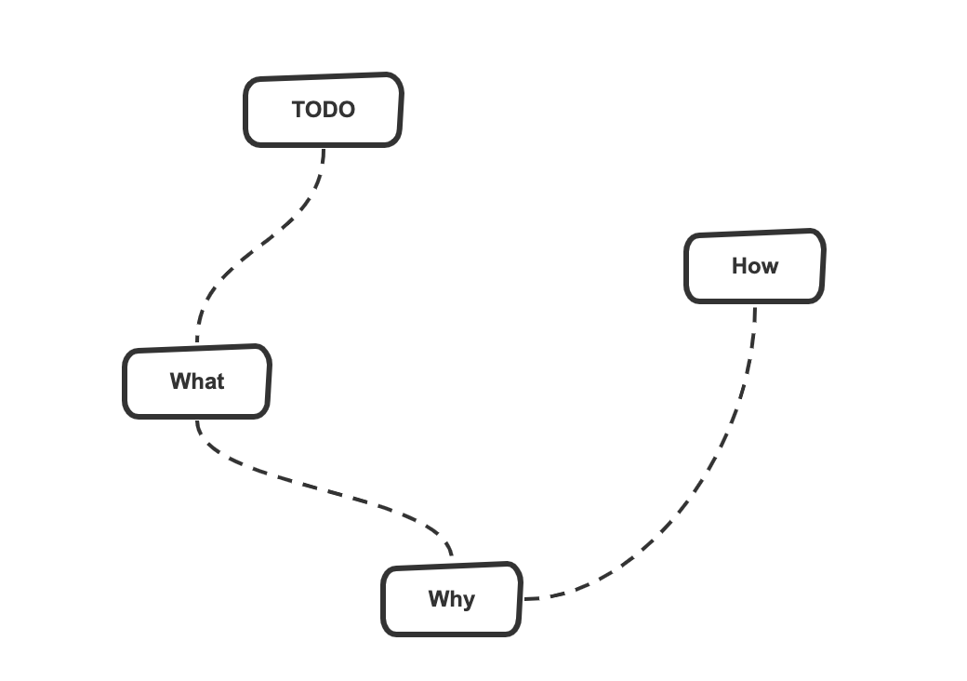
Journey

Slide 10
What
Is a tree representation of the abstract syntactic structure of source code written in a programming language.

Slide 11
What
example

Slide 12
Why
Can be edited and enhanced with information such as properties and annotations for every element it contains

Slide 13

Why

Slide 14
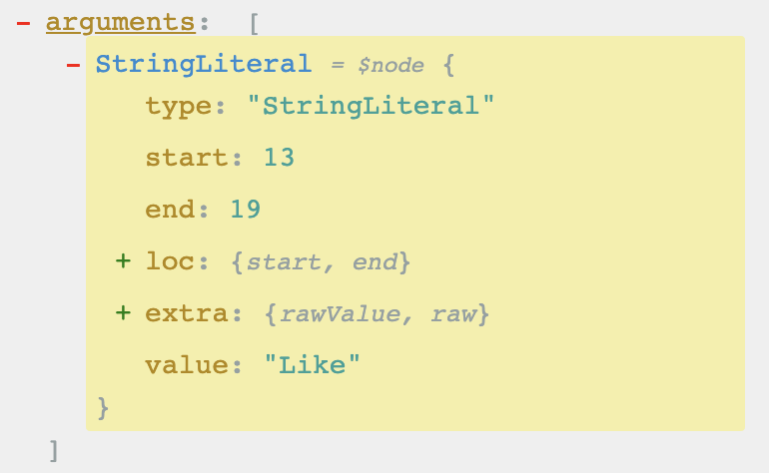
Why

Slide 15
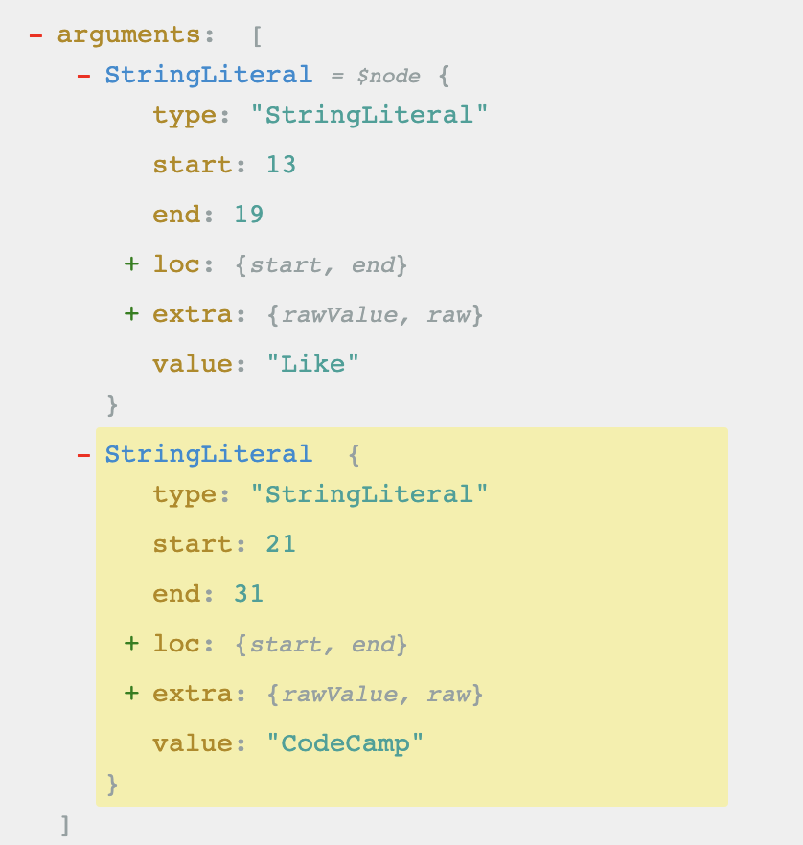
Why

Slide 16

Why

Slide 17
Why
Does not include inessential information (braces, semicolons, parentheses …)

Slide 18
Why
const result = (2 + 3) * 4;

Slide 19
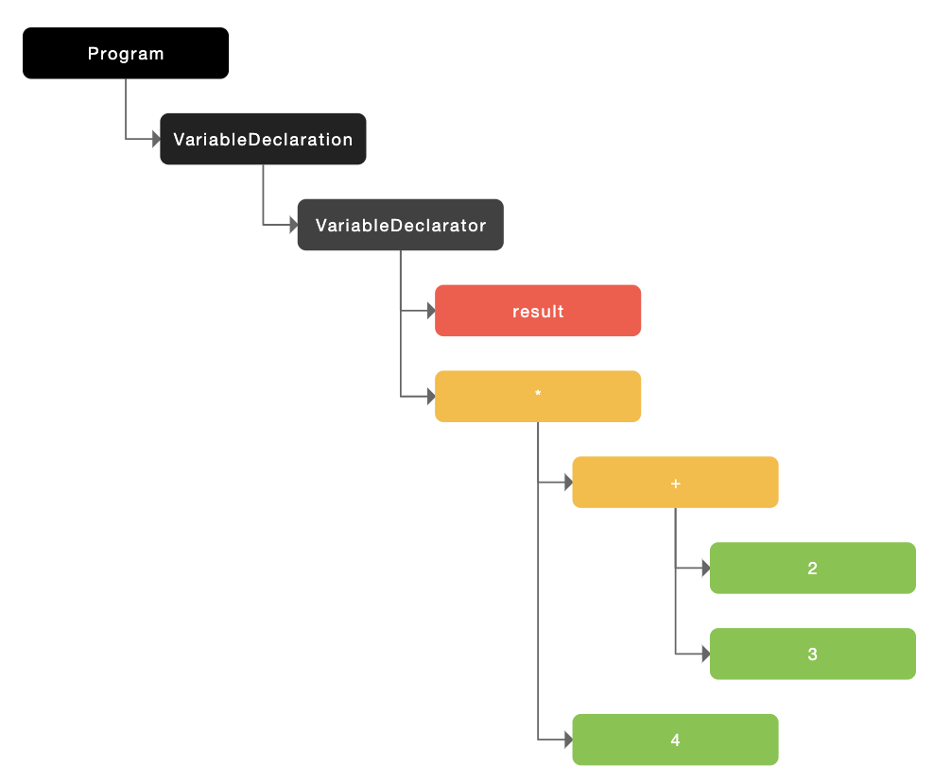
Why
const result = (2 + 3) * 4;

Slide 20
Why
Contains extra information about the program (store the position of each element in the source code)

Slide 21
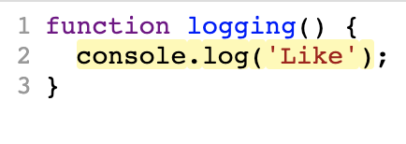
Why

Slide 22
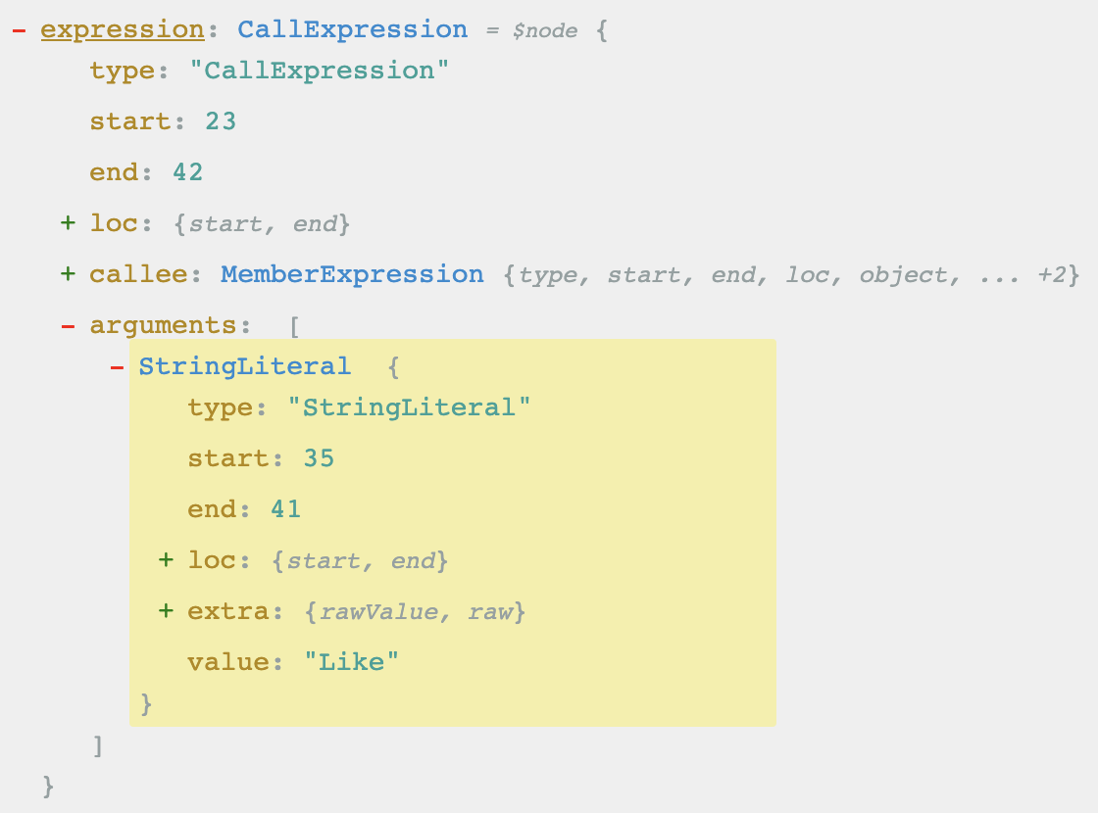
Why

Slide 23
Why
Can be edited and enhanced with information such as properties and annotations for every element it contains
Does not include inessential information (braces, semicolons, parentheses …)
Contains extra information about the program (store the position of each element in the source code)

Slide 24
How - parsers
@babel/parser
esprima
acorn
babylon

Slide 25
Visitor pattern
Separate algorithms from an object structure on which they operate

Slide 26
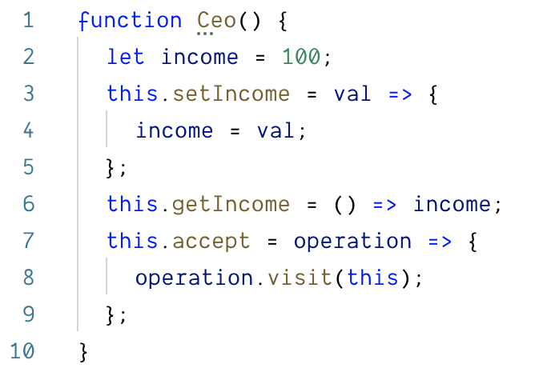
Visitor pattern

Slide 27
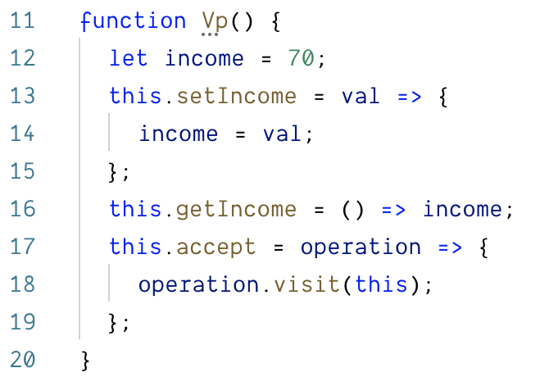
Visitor pattern

Slide 28
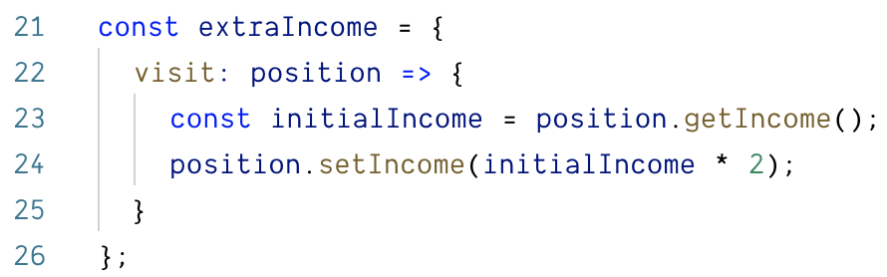
Visitor pattern

Slide 29
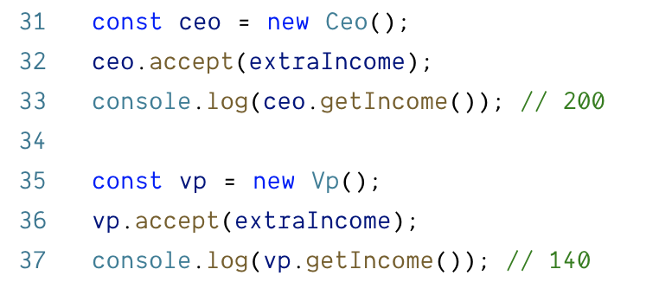
Visitor pattern

Slide 30
Resources
https://astexplorer.net/
JointJS AST graph
Babel Plugin Handbook
JavaScript to SVG flowchart

Slide 31
Thank you!

